Slide 1
No More NAFLD

Slide 2
Renaming NAFLD: Key Questions to Address
What are issues with current nomenclature and can they be addressed?
What is the importance of steatohepatitis in disease definition and endpoints?
How should the role alcohol be accounted for (or not)?
How might name change impact disease awareness, clinical trials and regulatory approval pathways?
Can an alternate name reduce heterogeneity and allow for future advances ?
Notes:
Based on these concerns, we sought to address the following key questions

Slide 3
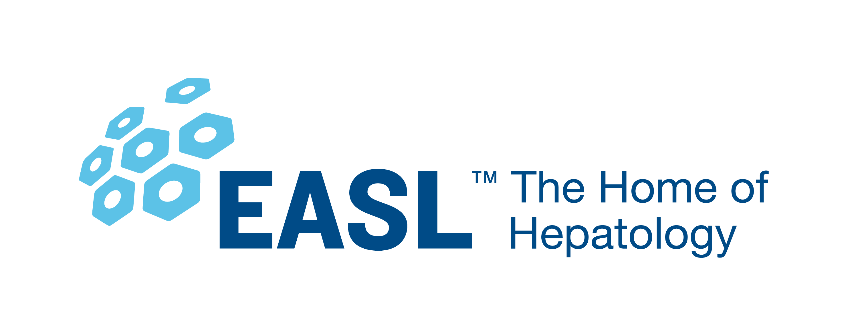
Multi-Society Effort – AASLD, EASL and ALEH
Key attributes of a Delphi consensus process:
Informed by subject matter experts
Conducted using rigorous methodology
Anonymity of voting and reporting of results
Transparency of process
Survey rounds combined with in-person discussion to facilitate consensus building
Acknowledgement of the value of diverse opinions
Assures that viewpoints are considered and discussed even if they don’t reach the consensus threshold
Notes:
Note lack of specified # allowing for range of rigor

Slide 4
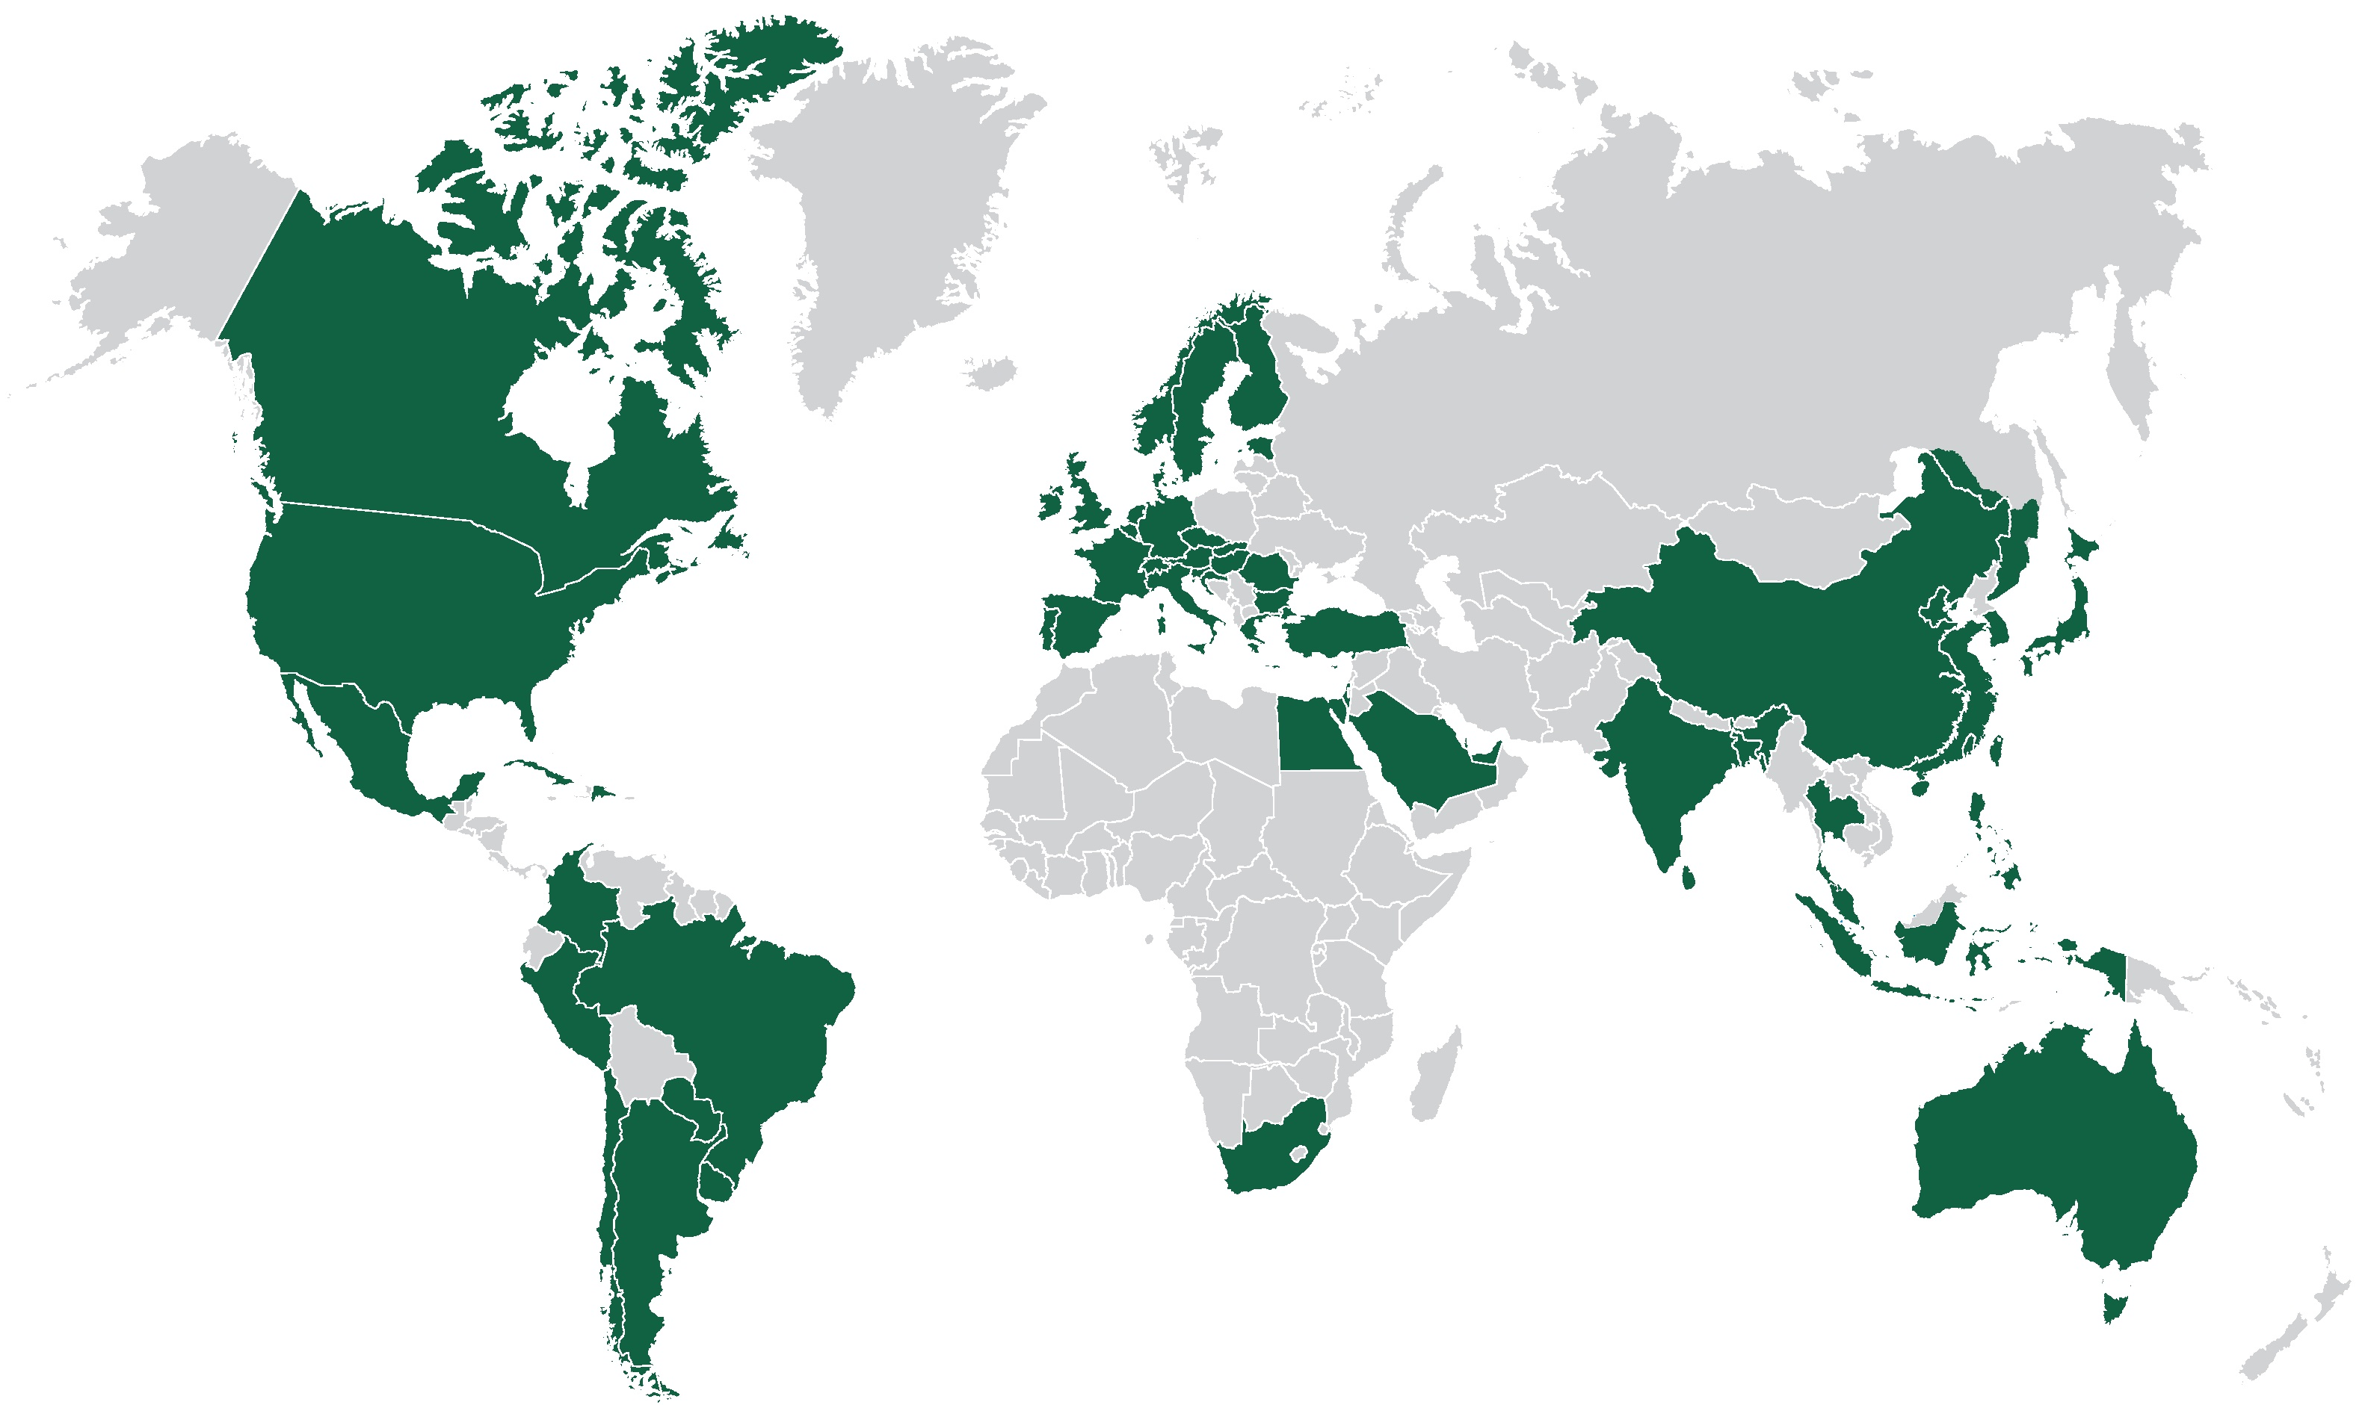
Global NAFLD Nomenclature Involvement
264 nominees from EASL, AASLD, ALEH, APASL, AMAGE, proportionate to association member size
56 countries represented

Slide 5
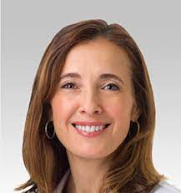
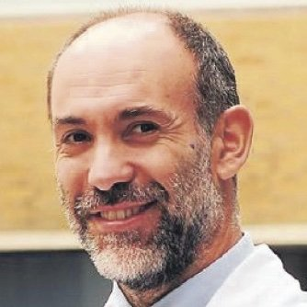
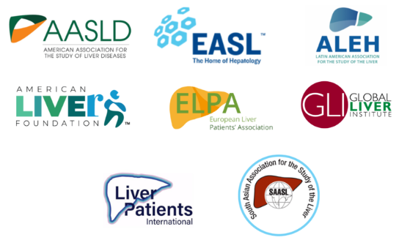
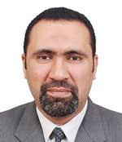
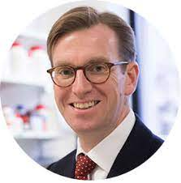
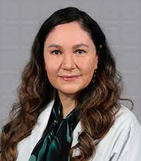
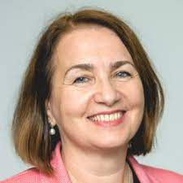
Global NAFLD Nomenclature Steering Committee
Publications: 8210
NAFLD publications: >4000
Median NAFLD: 89
Citations: >1,000,000
Average h-index: >74

Slide 6
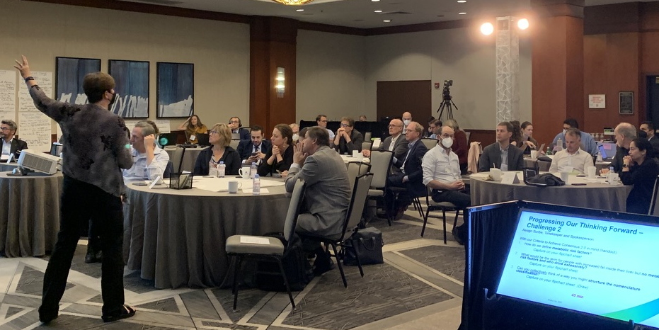
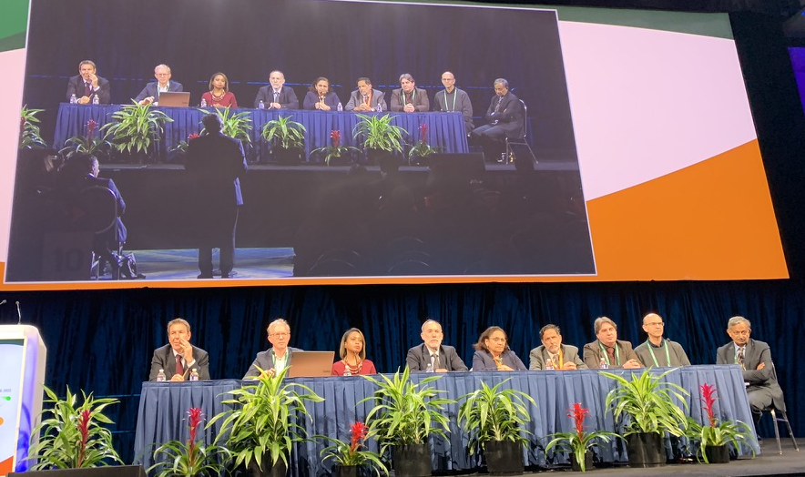
Overview of process
A priori threshold of consensus: Super majority (>67%)
✅
Round 1:
35 Questions/statements
⍨1000 comments
Chicago Nomenclature Consensus conference July 8-9, 2022 (61 in person, 69 virtual)
✅
Round 2:
52 Questions/statements
1366 comments
+
✅
Round 3:
42 Questions/statements
800 comments
✅
Round 4:
4 Questions/statements
Pan-society nomenclature meeting, Washington DC, TLM 2022
Notes:
After each round, comments were compiled, categorized and use to make modifications to the statements, meaning that

Slide 7
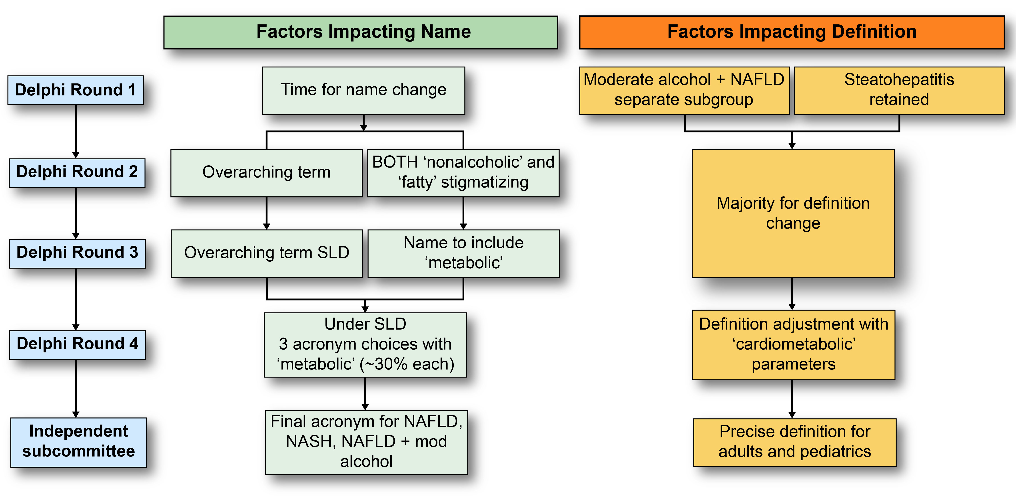

Slide 8
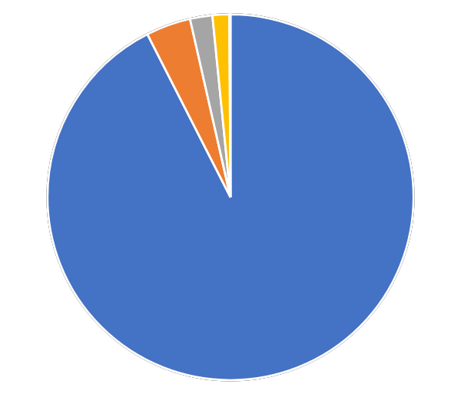
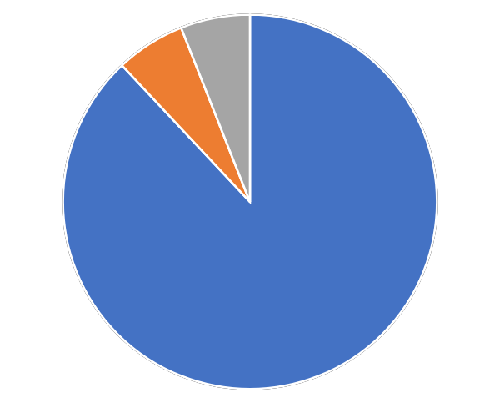
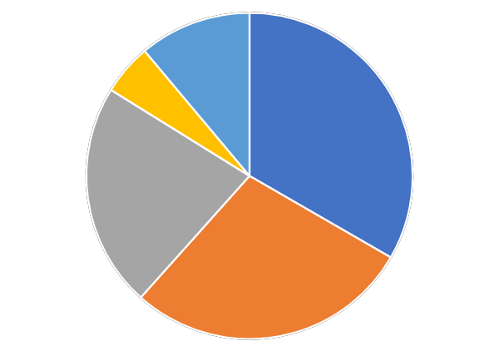
Acronym to replace NAFLD, NASH and overlap with alcohol
Metabolic dysfunction associated
steatotic liver disease
Metabolic dysfunction associated
steatohepatitis
Metabolic dysfunction and alcohol associated liver disease
Notes:
Arun

Slide 9
Definition
Affirmative set of diagnostic criteria for MASLD
Near universal agreement to err on side of being inclusive
Minimize patient heterogeneity and be adaptable to future insights
Simple, readily available and easily measurable parameters
The diagnostic criteria were also selected to align with cardiometabolic risk factors already well established and validated in other metabolic health disorders
The set of criteria for adults was then submitted to a subcommittee of five pediatric hepatologists who adapted them for the pediatric population
Notes:
Arun

Slide 10
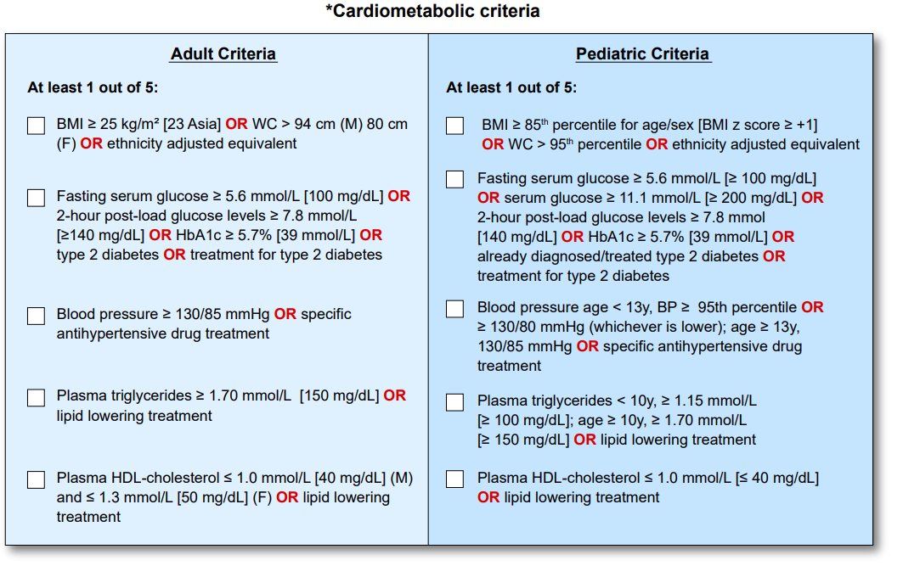
Notes:
Arun

Slide 11
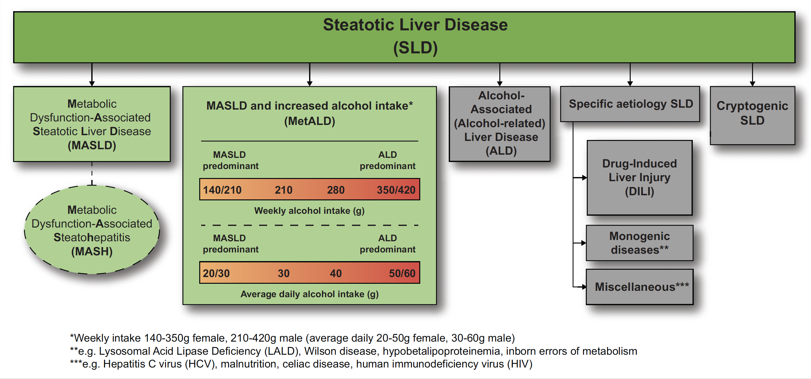
Consensus Nomenclature
Notes:
Arun

Slide 12
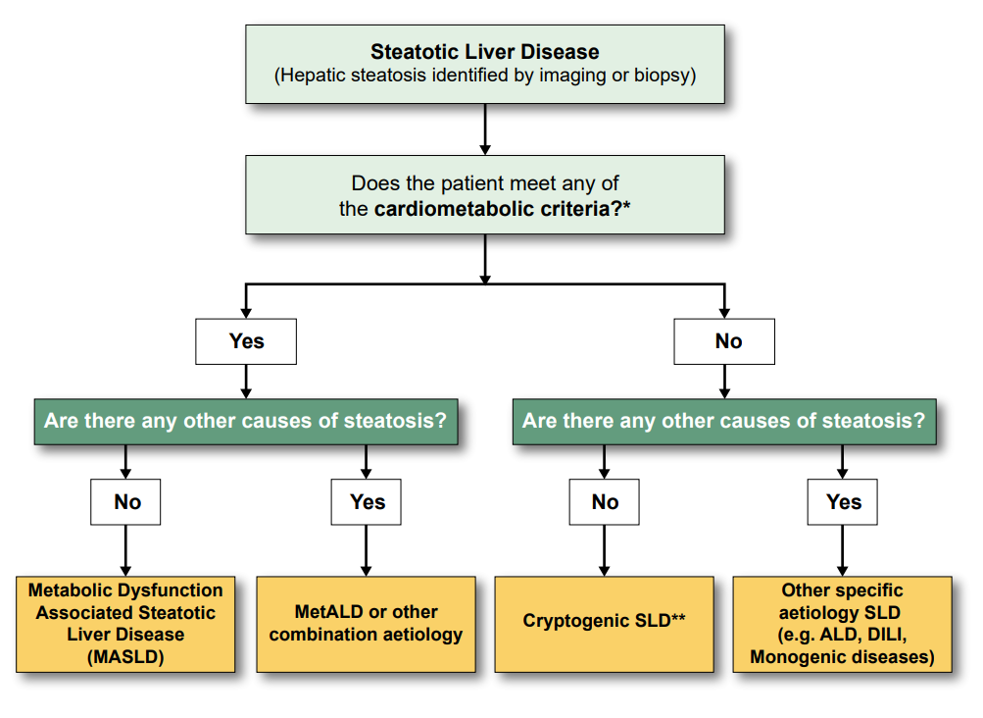
Decision Support Tool

Slide 13
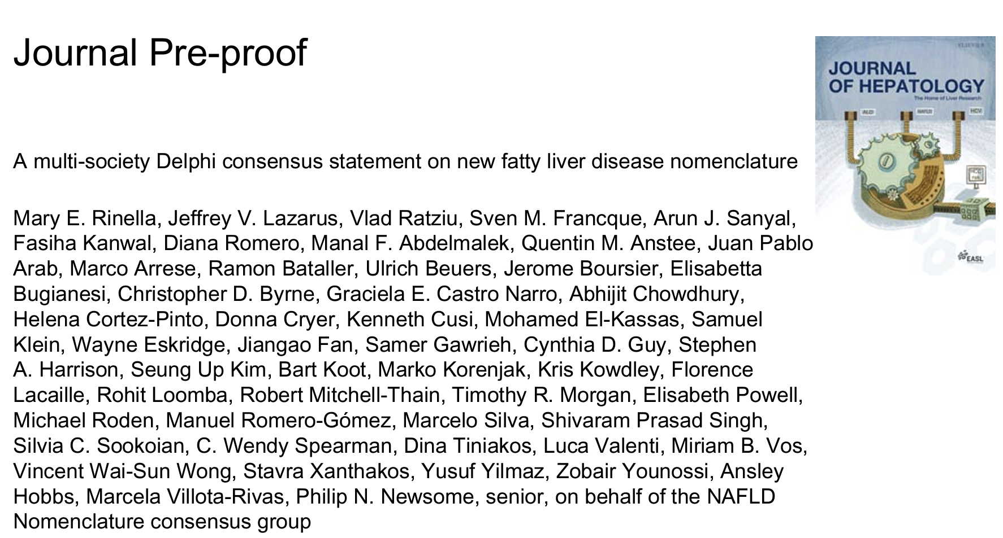
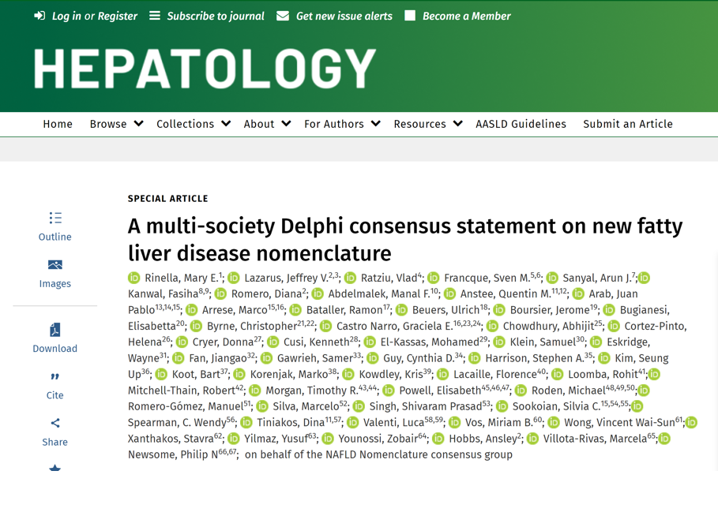
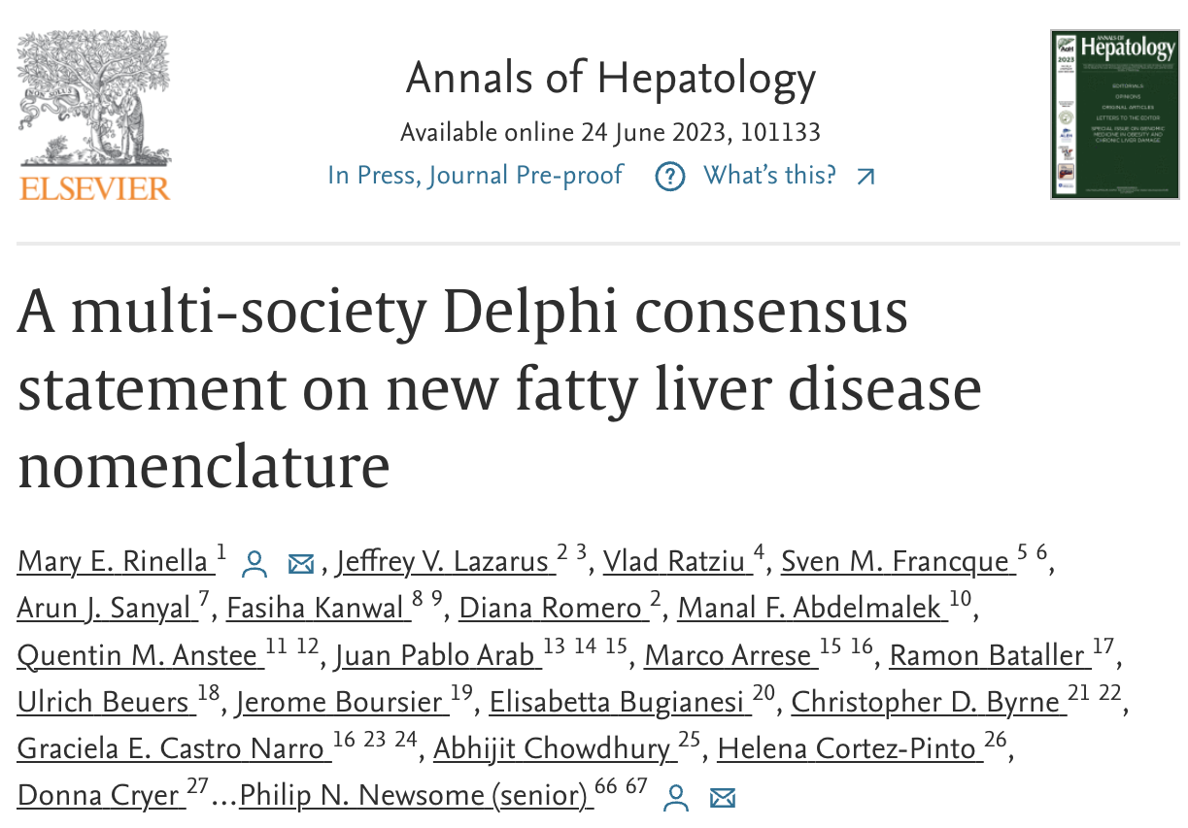

Slide 14
Endorsements – more than 70 societies

Slide 15
Overlap between NAFLD and MASLD
Impact interpretation of previously published data?
Impact on clinical trials?
Impact on qualification of biomarkers?

Slide 16
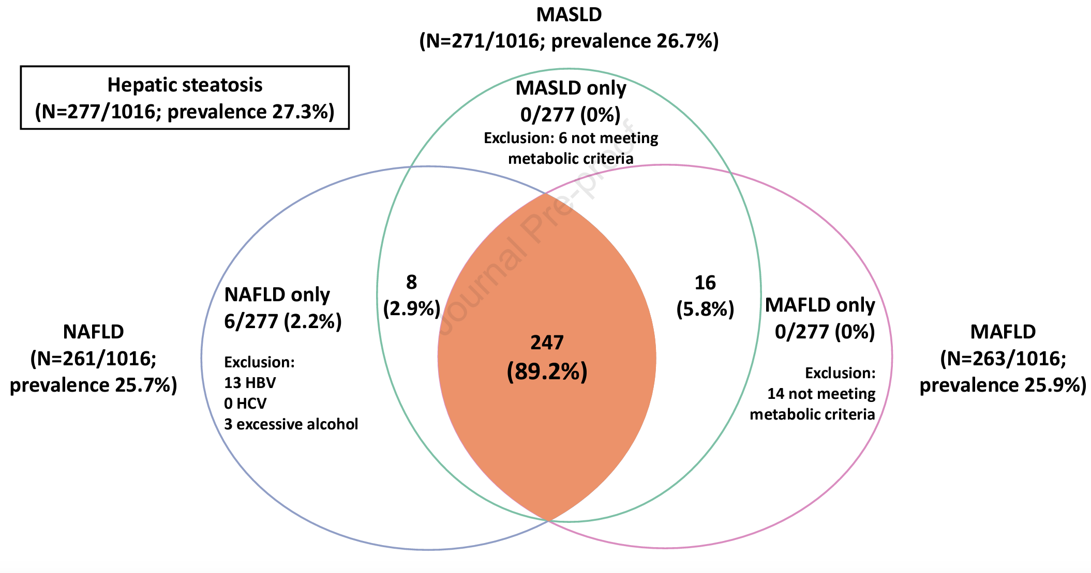
MASLD near complete overlap with NAFLD population
 | % not fulfilling MASLD | % not fulfilling MAFLD
Community sample (HK) NAFLD | 2.3% | 5.4%
Incident NAFLD | 10% | 24%
Biopsy proven NAFLD | 0.2% | 2.2%
Add publications
MASLD closer overlap with NAFLD than MAFLD in 3 Asian cohorts
Song et al. Can we use old NAFLD data under the new MASLD definition? J Hep 2023
Notes:
Fig. 1. (A) Venn diagram showing the distribution of patients with hepatic steatosis who fulfilled 1, 2, or all 3 definitions of MASLD, MAFLD, and NAFLD. Hepatic steatosis was diagnosed by proton-magnetic resonance spectroscopy in a population screening study of 1,016 apparently healthy individuals. (
1,016 randomly selected community subjects who had undergone proton-magnetic resonance spectroscopy in Hong Kong from 2008-2010 (mean age 48±10 years; 57.3% women; body mass index [BMI] 22.8±3.5 kg/m2).[5, 6] The population prevalence of NAFLD, MASLD, and MAFLD was 25.7% (95% Journal Pre-proof4 CI 23.1-28.5%), 26.7% (95% CI 24.0-29.5%), and 25.9% (95% CI 23.2-28.7%) respectively. Among 277 subjects with intrahepatic triglyceride content ≥5%, 89.2% met all three definitions (Fig. 1A). Among 261 patients with NAFLD, only 6 (2.3%) and 14 (5.4%) did not fulfil the metabolic criteria of MASLD and MAFLD respectively.

Slide 17
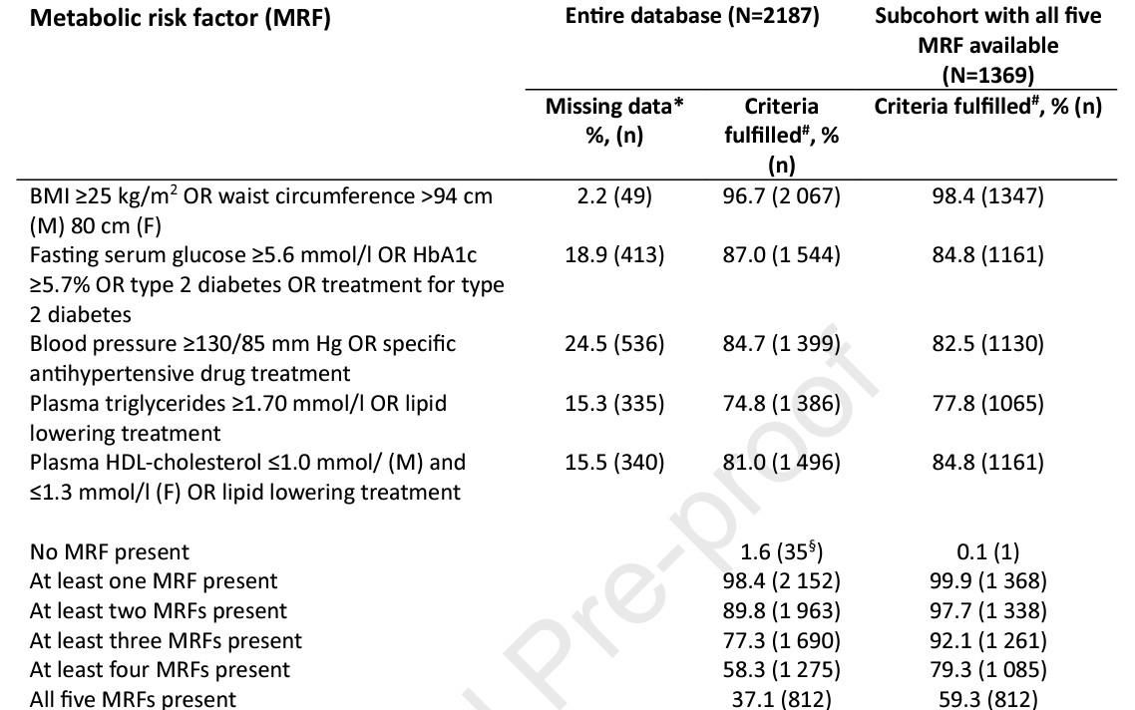
Near complete overlap in biomarker population
Data acquired for NAFLD are valid for MASLD
Nomenclature change will not impact biomarker development
Ratziu et al. Confirmatory biomarker diagnostic studies are not needed when transitioning from NAFLD to MASLD. J Hep 2023

Slide 18
Capture of ‘lean’ NAFLD – MASLD captures more left out with MAFLD criteria
Indian real world cohort of 1643 patients with NAFLD, 170 ‘lean’
84% fulfilled MASLD definition
49.4% fulfilled MAFLD definition
De et al. Metabolic dysfunction-associated steatotic liver disease (MASLD) definition is better than MAFLD criteria for lean patients with non-alcoholic fatty liver disease (NAFLD). J Hep 2023
Notes:
Metabolic risk profile in lean patients with NAFLD (n=170)

Slide 19
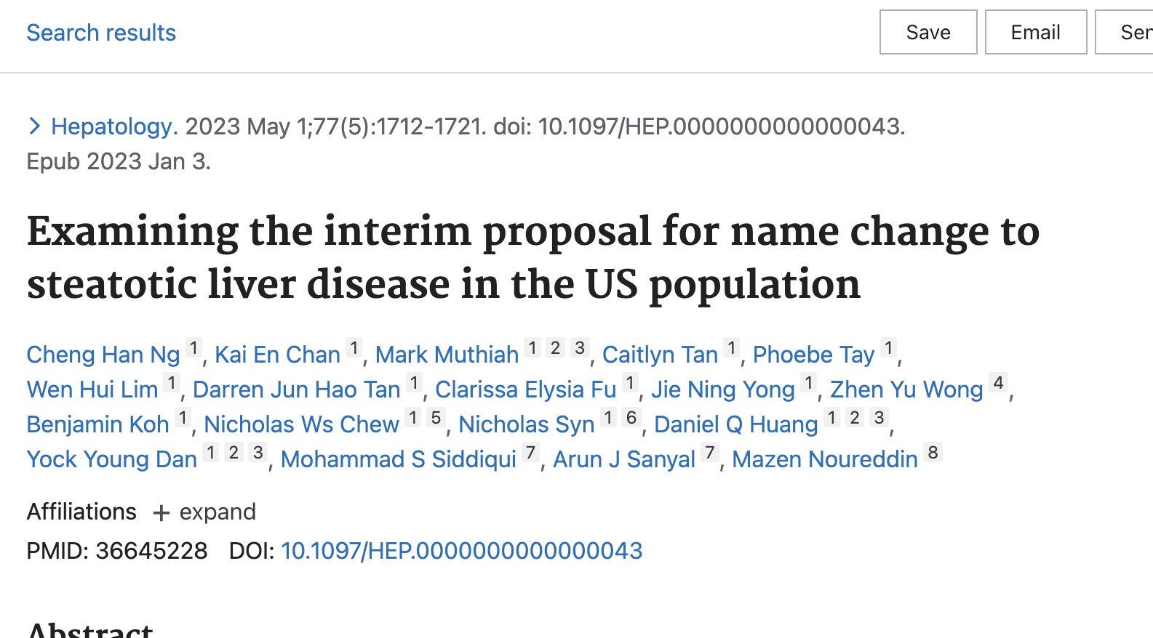
Stigma
Stigma varies between individuals, cultures and languages
When possible, its important to avoid the use of potentially stigmatizing language
More on stigma is forthcoming

Slide 20
New opportunities for research

Slide 21
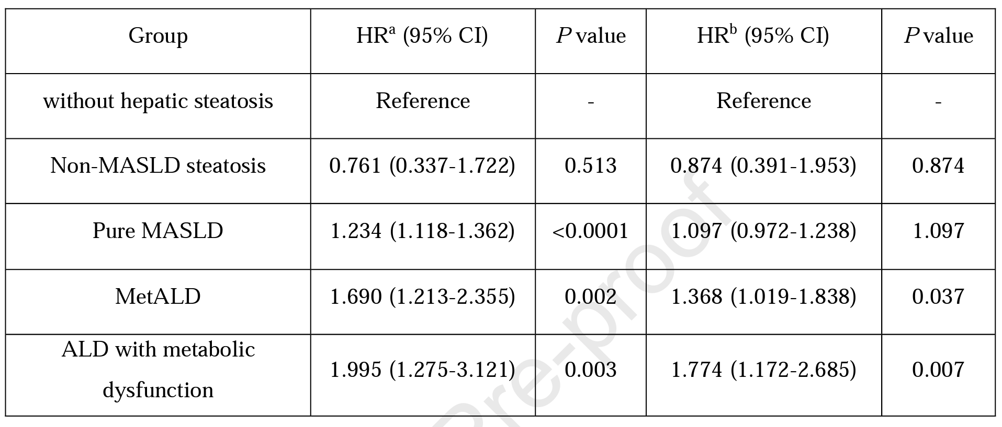
SLD subtypes: Comparison of all-cause mortality
Li and Xie. Are there all-cause mortality differences between metabolic dysfunction-associated steatotic liver disease subtypes? J Hep 2023
Ciardullo et al. Exploring the landscape of steatotic liver disease in the general US population. Liver International 2023
Notes:
Ciardullo: data from NHANES – 99.4% of those with steatosis met CM criteria

Slide 22
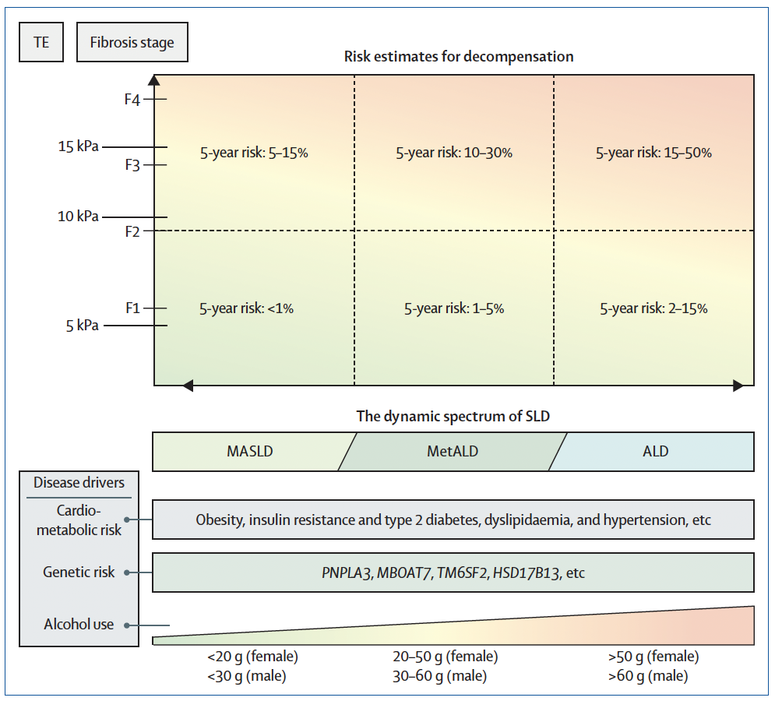
Dynamic specrum of MASLD-MetALD-ALD
Alcohol use interacts with cardiometabolic risk factors and impacts risk of decompensation
Israelsen et al. MetALD: new opportunities to understand the role of alcohol in steatotic liver disease. Lancet GI Hep 2023
Notes:
Figure: The dynamic spectrum of steatotic liver disease
The graph shows how the disease drivers of SLD (x-axis) and the severity of liver disease (y-axis) determine the risk of developing decompensated liver disease within 5 years. Risk estimates derived from observational studies.^{8,11–13} ALD=alcohol-related liver disease. F1=fibrosis stage 1. F2=fibrosis stage 2. F3=fibrosis stage 3. F4=fibrosis stage 4. MASLD=metabolic dysfunction-associated steatotic liver disease. SLD=steatotic liver disease. TE=transient elastography.

Slide 23
Official Nomenclature Launch – June 24, 2023 (ILC)
Marketing/Press release
Leadership Message from Norah Terrault
Press release – issued Saturday June 24
Membership Message from Norah Terrault
SIG Message from NAFLD SIG co-chairs
Website/Social media
New page built with videos and figures
Twitter posts - https://twitter.com/AASLDtweets
Videos - https://www.aasld.org/new-nafld-nomenclature
Diagnosis tool in development

Slide 24
Effective implementation
Associations
Patients
Regulators
Unity
Providers
Billing and coding
Pharma
Notes:
The proposed nomenclature allows the flexibility for refinement as new evidence emerges about underlying pathophysiology and risk factors.

Slide 25
Discussion at meetings
Use in publications
Use in practice
Public
Govt
Awareness and implementation
ILC
ALEH meeting
UEG
AASLD
Other national meetings
Individual symposia and society meetings
Pan-society leadership editorial
Delphi paper in 3 journals
Editorials in society journals and outside
Consultation with providers
Patient focus groups
FAQs
Notes:
Patients: focus groups for how we should discuss disease. Will there be a distinction between what we describe to patients and what the disease is officially called

Slide 26
Medical societies
Regulators
Industry
Public
Govt
Global
Dissemination
Endorsement process ongoing
Engagement ongoing

Slide 27
Next Steps
Stakeholder meetings to determine implementation challenges and needs
Development of:
MASLD living guidelines on aasld.org
Decision tree and infographics
PowerPoint presentations on the new nomenclature available for use
Campaign to increase awareness and adoption
Society driven
Collaboration with industry

